Slide 1
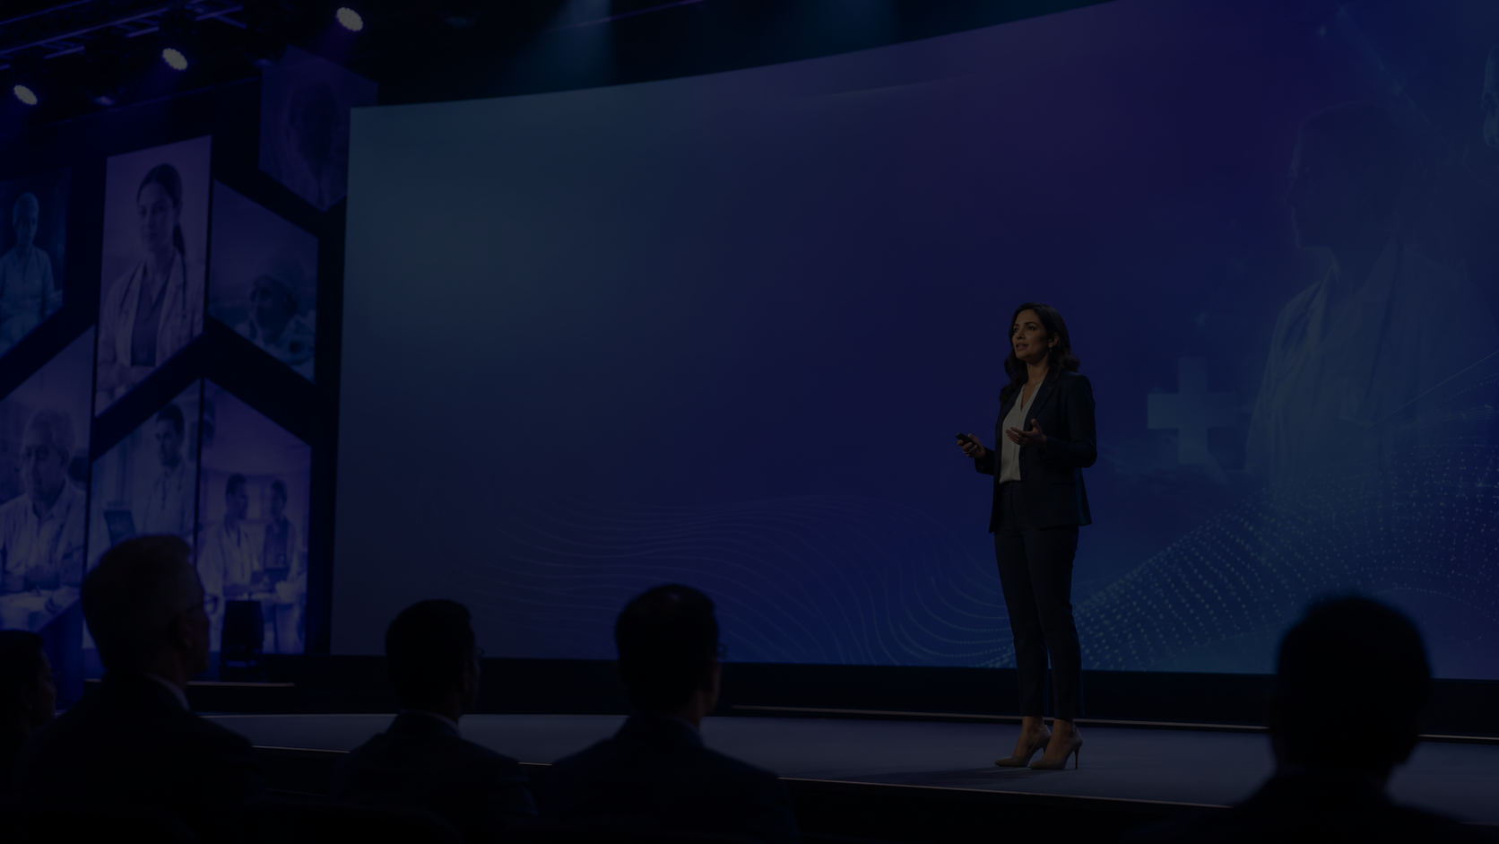
BSS™
Human Stability Intelligence
BSS™ Caregiver
Stability AI
Close-proximity Human Stability Intelligence for safer aging, caregiver awareness, and earlier review of instability patterns.
HLTH 2026 Startup Pitch Application Deck
Lathell Sancho
Founder & Inventor
Lathell Nutraceuticals LLC
l.sancho@lathellnutraceuticalsllc.com

Slide 2

The caregiver gap
BSS™
Human Stability Intelligence
Families sense changes before systems measure them.
“Something seems off” is not enough.
Subtle instability can appear before a fall, fatigue event, dehydration risk, mobility decline, or care escalation.
Caregivers often lack a measurable way to understand what changed, how serious it may be, or what action to take.
Current tools often react after an event; BSS™ is designed for earlier awareness and professional review prompts.
BSS™ translates early human stability cues into a structured signal caregivers can understand.
Lathell Nutraceuticals LLC | BSS™ Caregiver Stability AI | Non-diagnostic support for caregiver awareness

Slide 3

BSS™
The BSS™ answer
Human Stability Intelligence
A close-proximity Human Stability Intelligence platform that scores measurable changes and routes the next step.
1
Scan / input
Multimodal signal capture or structured MVP inputs
2
Compare
Personal baseline + drift logic
3
Score
Human Stability Index™ 1-5
4
Route
Caregiver alert, rescan, or professional review prompt
Non-diagnostic boundary: BSS™ identifies measurable stability patterns and supports timely review; licensed professionals make diagnosis and treatment decisions.
Lathell Nutraceuticals LLC | BSS™ Caregiver Stability AI | Non-diagnostic support for caregiver awareness and professional review

Slide 4
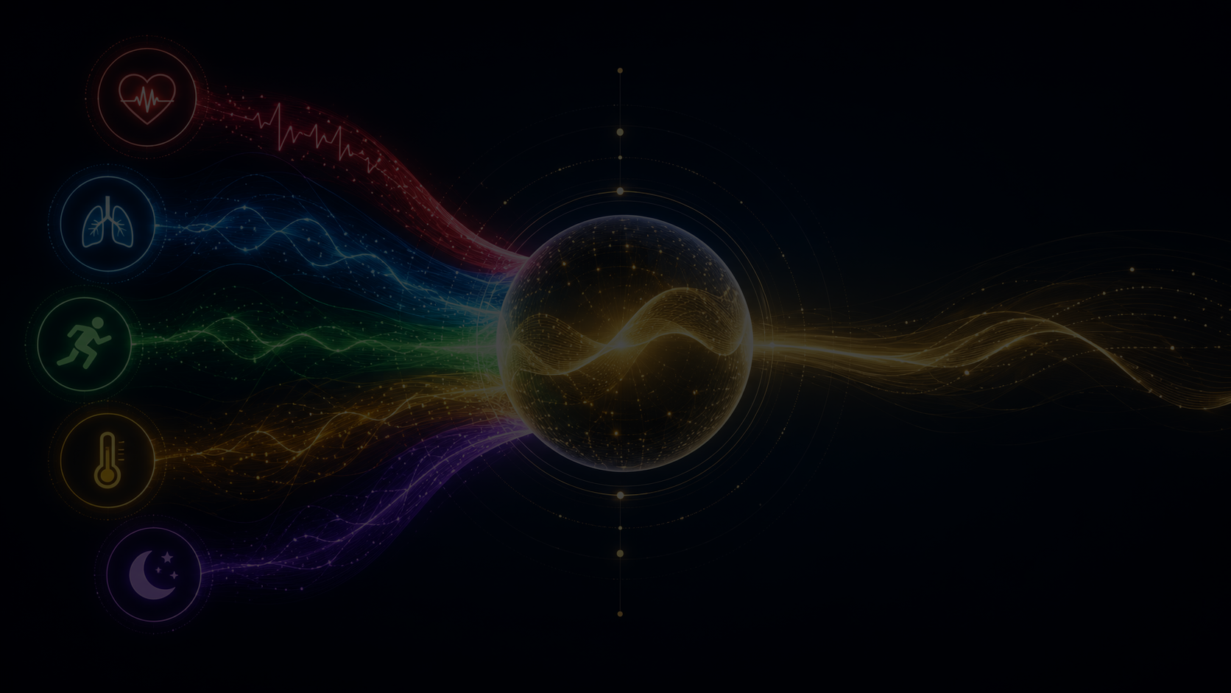
How it works
BSS™
Human Stability Intelligence
Signal fusion becomes one caregiver-ready stability output.
INPUTS
PROCESSING
SCORING
ACTION
Physiology
HRV, pulse, oxygenation, respiration, thermal load
Baseline + drift
what changed from personal normal?
HSI™ 1-5
stability score + top drivers
Caregiver workflow
alert, trend, rescan, or review guidance
Movement
gait, balance, posture, motion stability
Signal quality
confidence, noise, no-score / rescan rules
Lathell Nutraceuticals LLC | BSS™ Caregiver Stability AI | Non-diagnostic support for caregiver awareness and professional review

Slide 5
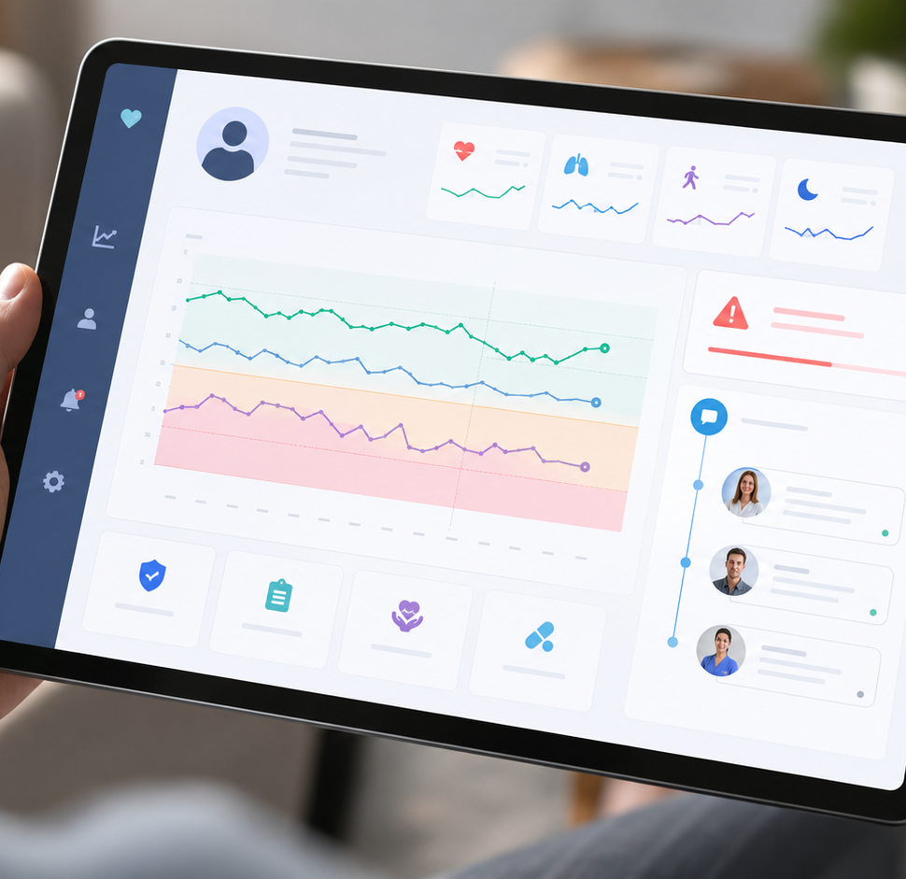
BSS™
MVP: software-first pathway
Human Stability Intelligence
Built to satisfy the AgeTech requirement without overclaiming a finished medical device.
HSI™ scoring core
1
Structured scoring, confidence, top drivers, no-score/rescan logic
Caregiver dashboard
2
Simple stability status, trends, alerts, review guidance
Structured input testing
3
Simulated and collected signal-input workflows before dedicated hardware
Pilot protocol
4
Caregiver feedback, usability, repeatability, and escalation logic
Lathell Nutraceuticals LLC | BSS™ Caregiver Stability AI | Non-diagnostic support for caregiver awareness and professional review

Slide 6
The product experience
BSS™
Human Stability Intelligence
Caregivers get one clear status, not a wall of raw numbers.
Human Stability Index™
1 = stable / 5 = urgent review pattern
Top drivers
Movement change, fatigue load, respiratory variance, thermal stress, sleep/recovery drift
Confidence & rescan
Flags noisy or incomplete scans before escalation
Next-step guidance
Monitor, rescan, notify caregiver, or seek professional review
Lathell Nutraceuticals LLC | BSS™ Caregiver Stability AI | Non-diagnostic support for caregiver awareness and professional review

Slide 7
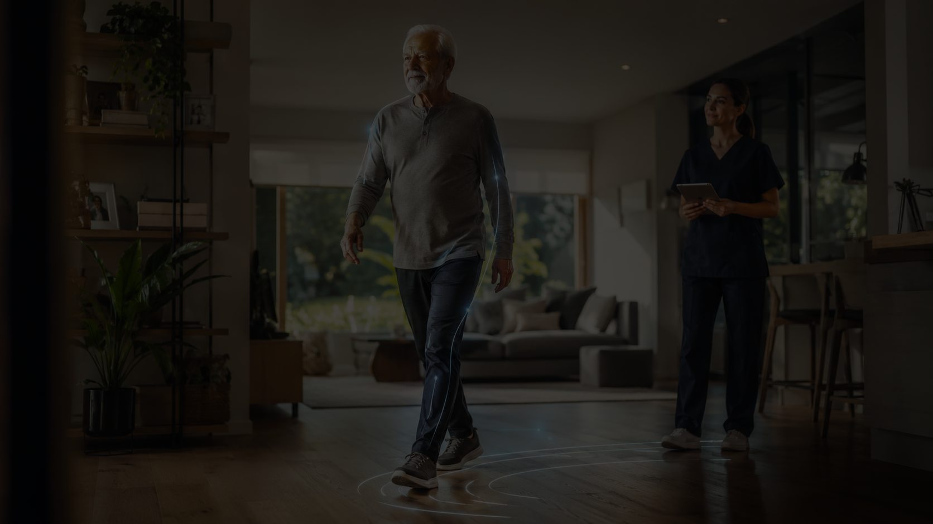
BSS™
Why AgeTech needs BSS™
Human Stability Intelligence
Aging-in-place requires earlier awareness, not only emergency response.
Home-care agencies need scalable monitoring workflows.
Family caregivers need confidence about when to act.
Senior-living operators need trend visibility and safer escalation pathways.
Older adults need independence with less intrusive observation.
BSS™ is designed to help people stay safer, longer, and more connected.
Lathell Nutraceuticals LLC | BSS™ Caregiver Stability AI | Non-diagnostic support for caregiver awareness and professional review

Slide 8
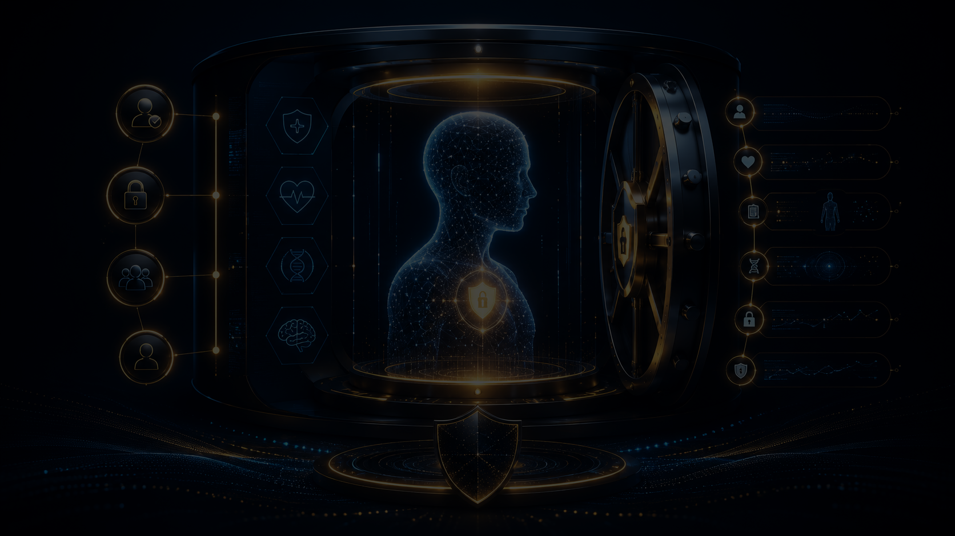
BSS™
BSS Vault™: trust + continuity
Human Stability Intelligence
A consent-based stability history that follows the person across care settings.
Personal baseline
What is normal for this person?
Incident replay
What data supported the alert?
Caregiver access
Who is authorized to see alerts?
Recovery scoring
Did stability return toward baseline?
Drift timeline
What changed and when?
Lathell Nutraceuticals LLC | BSS™ Caregiver Stability AI | Non-diagnostic support for caregiver awareness and professional review

Slide 9

BSS™
Commercial path
Human Stability Intelligence
Pilot first. Validate workflow. Convert into subscriptions and enterprise deployments.
1
Pilot partners
2
Subscription model
3
Enterprise deployment
4
Hardware pathway
home-care, senior living, caregiver programs
caregiver dashboard + BSS Vault™ access
care organizations, wellness platforms, payers
validated integrations and dedicated BSS™ devices
Initial use cases: safer aging, caregiver confidence, home-care triage, senior-living trend awareness, and wellness monitoring.
Lathell Nutraceuticals LLC | BSS™ Caregiver Stability AI | Non-diagnostic support for caregiver awareness and professional review

Slide 10
BSS™
The ask
Human Stability Intelligence
Help BSS™ move from protected invention and MVP design into real-world AgeTech pilot deployment.
HLTH / AARP support
Pitch exposure, accelerator consideration, AgeTech partners, and strategic introductions
Contact
Lathell Sancho
Founder & Inventor
Lathell Nutraceuticals LLC
l.sancho@lathellnutraceuticalsllc.com
Pilot partners
Home-care organizations, senior-living groups, caregiver networks, wellness platforms
BSS™ turns human intuition into measurable Human Stability Intelligence.
Capital target
$250K-$1M to complete MVP, dashboard, scoring core, validation, and initial pilots
Lathell Nutraceuticals LLC | BSS™ Caregiver Stability AI | Non-diagnostic support for caregiver awareness and professional review

